Slide 1
CSC 215-01: ARTIFICIAL INTELLIGENCE FINAL PROJECT PRESENTATION One Shot Learning for Acute Kidney Injury Prediction
Team Members:
Harshitha Onkar (Sac Id: 220262706)
Gargi Prabhugaonkar (Sac Id: 301111525)

Slide 2
Agenda
Problem statement
Introduction
Related work
Background
System Architecture – High-level design
Detailed design
Methodology
Results & comparisons
Challenges & takeaways
Task division
References

Slide 3
Problem Statement
To predict postoperative Acute Kidney Injury after liver cancer resection by using a Triplet Siamese Model and Deep Learning Classifier Models.

Slide 4
Introduction
What is Acute Kidney Injury (AKI) ?
Kidneys stop working suddenly, over a very short period and cause due to increase in serum creatinine levels
Complication in patients undergoing surgery
Kidney Disease Improving Global Outcomes (KDIGO) provides practical guidelines for AKI.
Early prediction of AKI can be beneficial to patients as well as doctors
Timely actions can be facilitated to save several lives affected by AKI

Slide 5
Related Work
Base paper - Previous work on AKI prediction using Machine Learning
L. Lei, Y. Wang, Q. Xue, J. Tong, C. Zhou and J. Yang, "A comparative study of machine learning algorithms for predicting acute kidney injury after liver cancer resection," PeerJ, pp. 8, e8583., 2020.
Triplet Network- Train output to compact embedding using Triple Loss Function
F. K. D. &. P. J. Schroff, "Facenet: A unified embedding for face recognition and clustering," in Proceedings of the IEEE conference on computer vision and pattern recognition, 2015.

Slide 6
Background
What are Siamese Networks?
Based on similarity function
Takes two inputs-one actual and other candidate
Outputs similarity between two inputs
Similar inputs result in lower output values

Slide 7
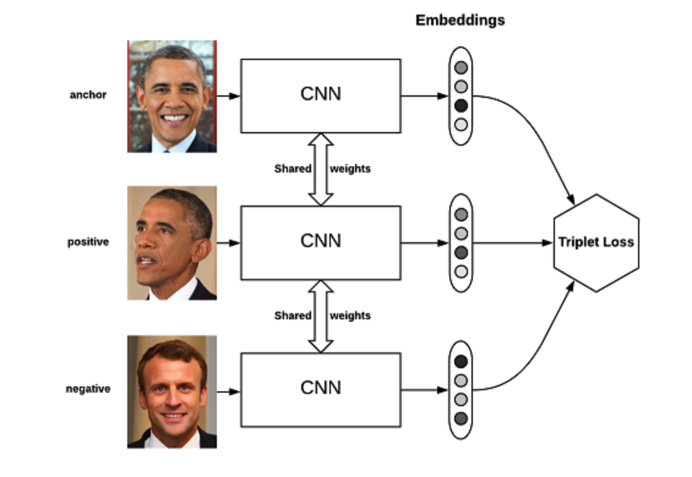
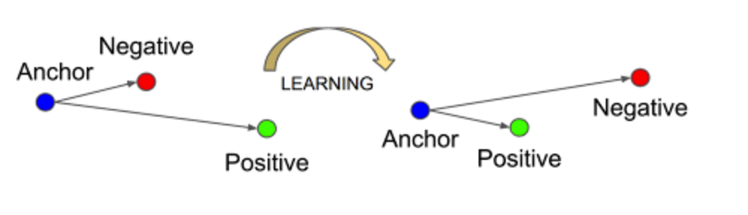
Background
Triple Loss integration
Compare pairs and learn parameters of neural the network
Compute distance between anchor and positive (matching)
Computer distance between anchor and negative (non-matching)

Slide 8
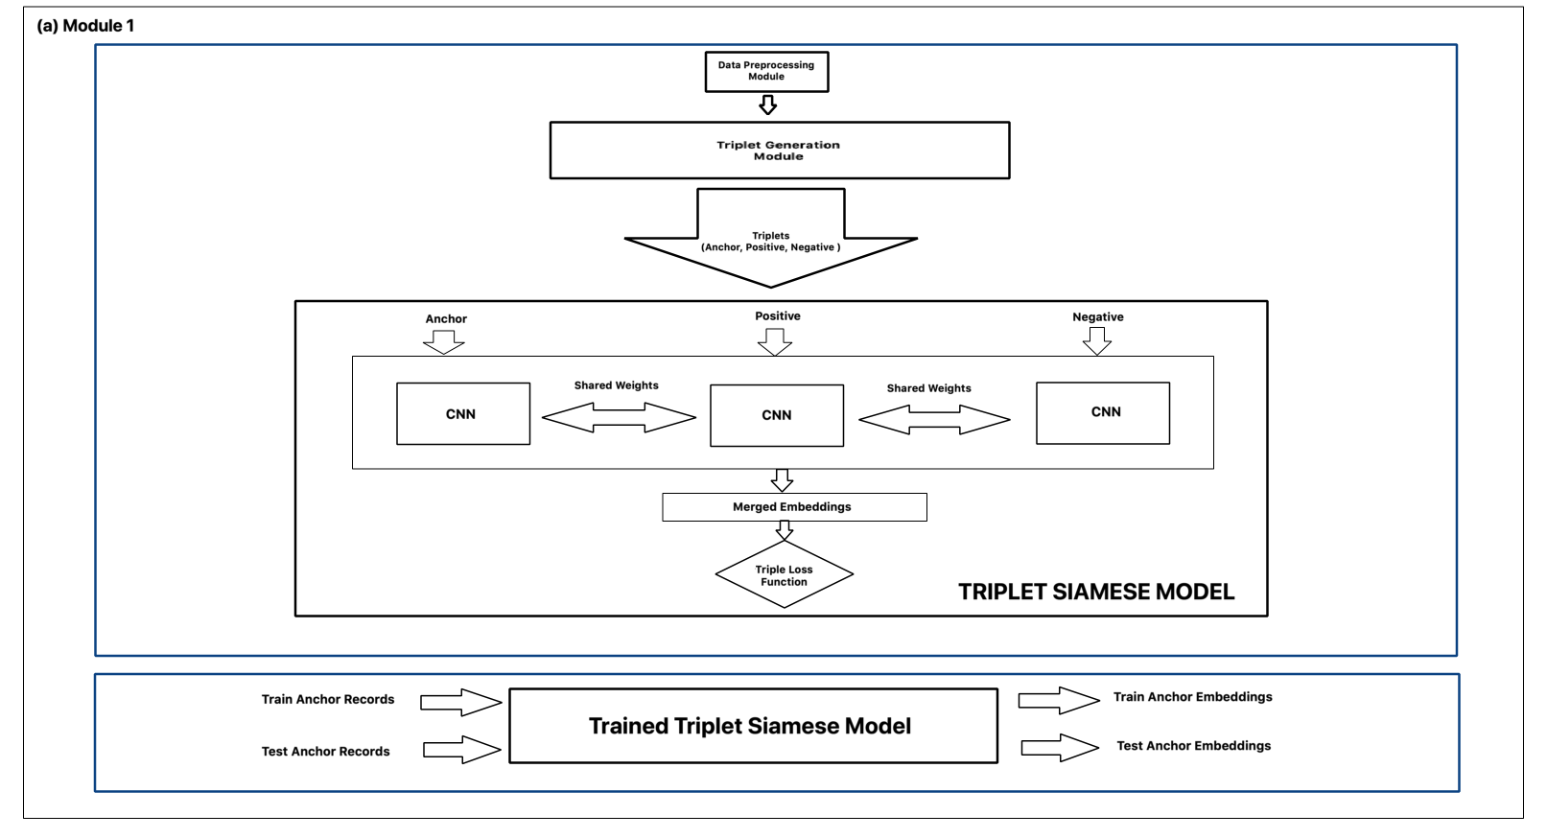
System Architecture- Triplet Siamese Model

Slide 9
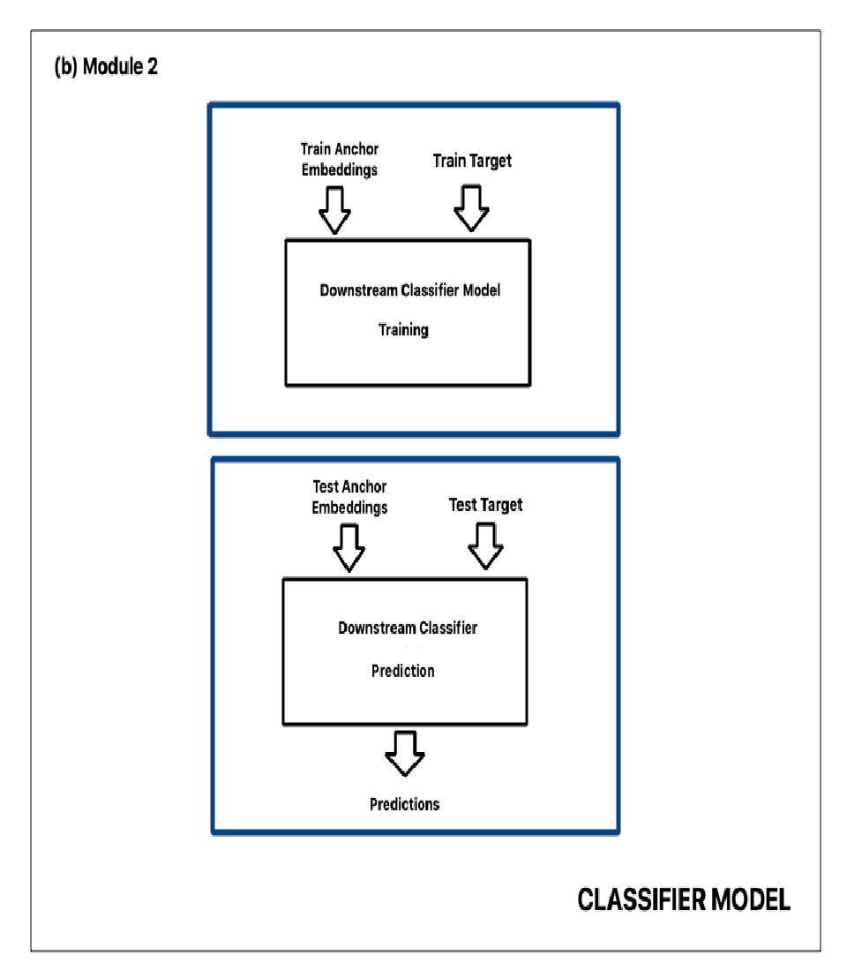
System Architecture- Downstream Classifier

Slide 10
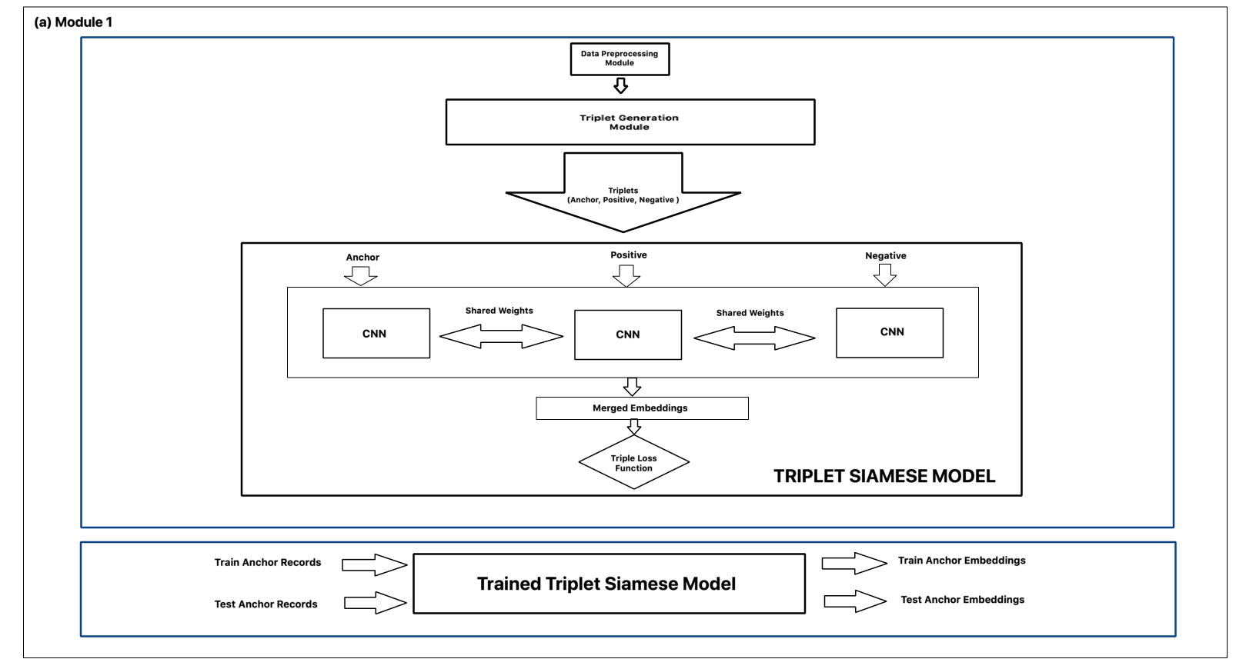
High-Level Design

Slide 11
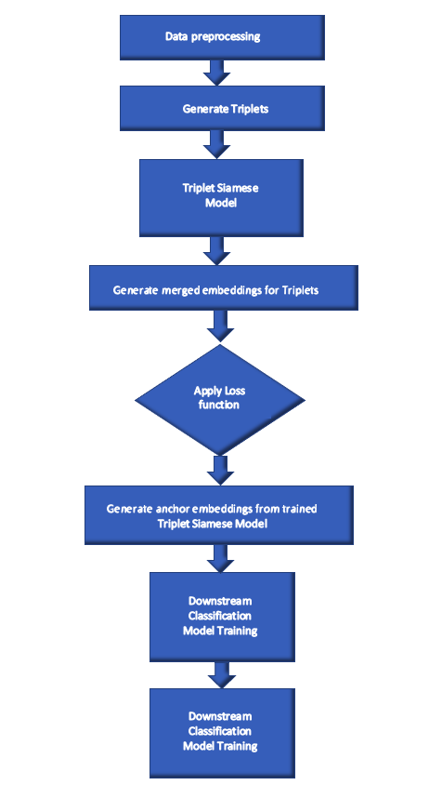
Detailed Design
Flow chart
Main components
Triplet Generator
Triplet Siamese Network
Trained model to obtain anchor embeddings
Downstream classification model

Slide 12
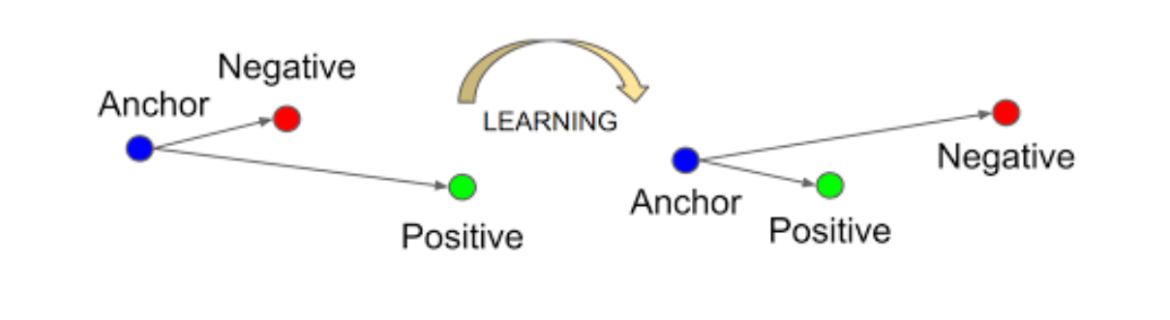
Triplet Generator
Two ways of triplet generation - Offline and Online
Used Offline triplet mining – Random and Variation where each AP pair of each class is combined with every N pair
Triplets generated as [AKI, AKI, non-AKI] or [non-AKI, non-AKI, AKI]

Slide 13
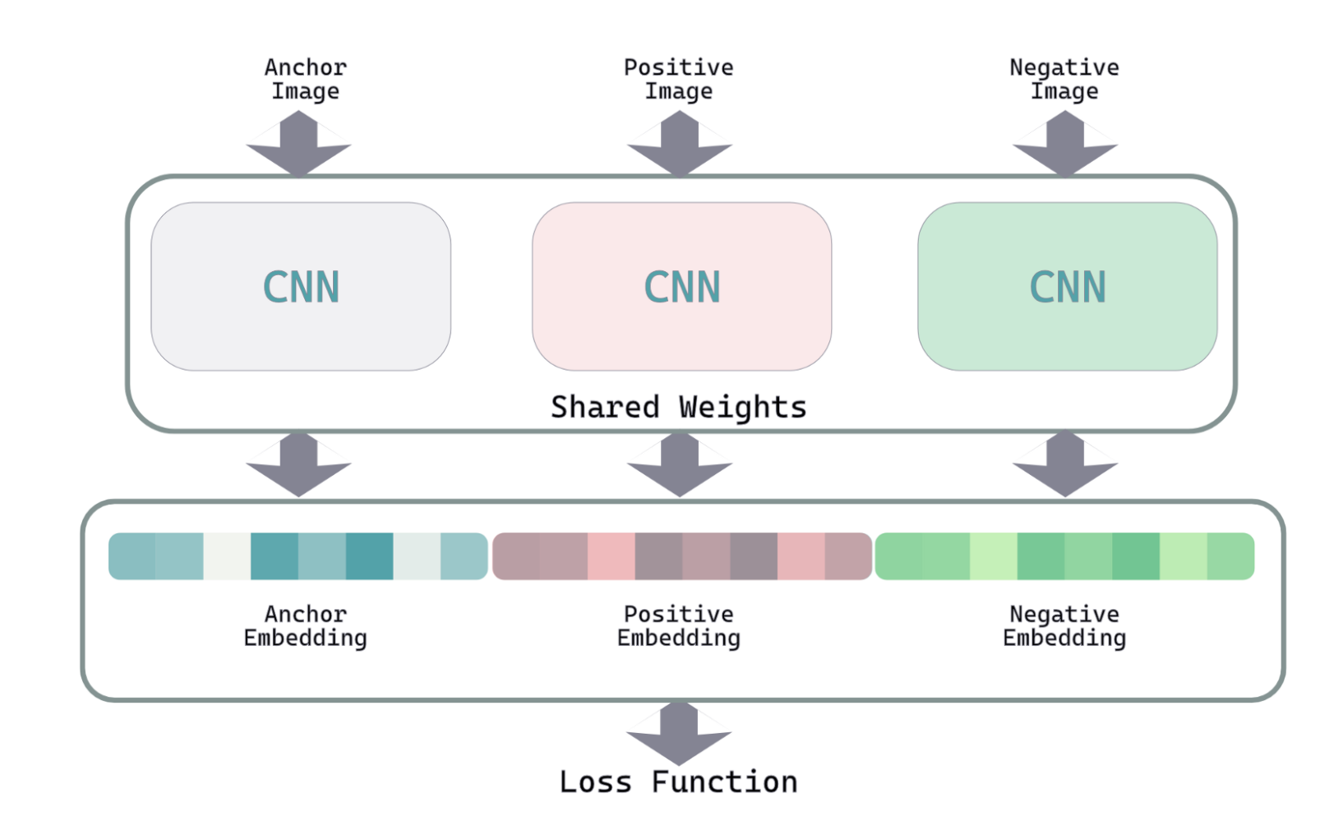
Triplet Siamese Network
Consists of embedding model + concatenation layer + triplet loss function
Embedding model is a shared weights channel, each component of triplet – A,P,N goes through the same channel
Concatenation layer merges all the 3 embeddings into one
The triplet loss function is computed on these embeddings

Slide 14
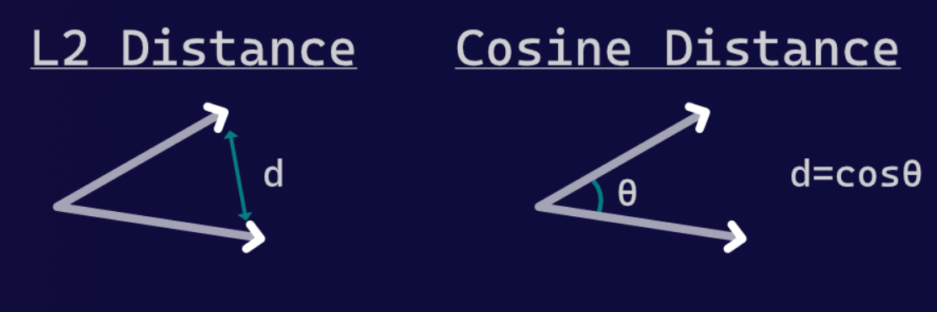
Triplet Loss Function
Main component of Triplet network that enables to learn similar and dissimilar records
It is a custom loss function
Can be defined in terms of Cosine similarity or Euclidean distance between AP and AN pairs
Defined on alpha – margin and embedding size

Slide 15
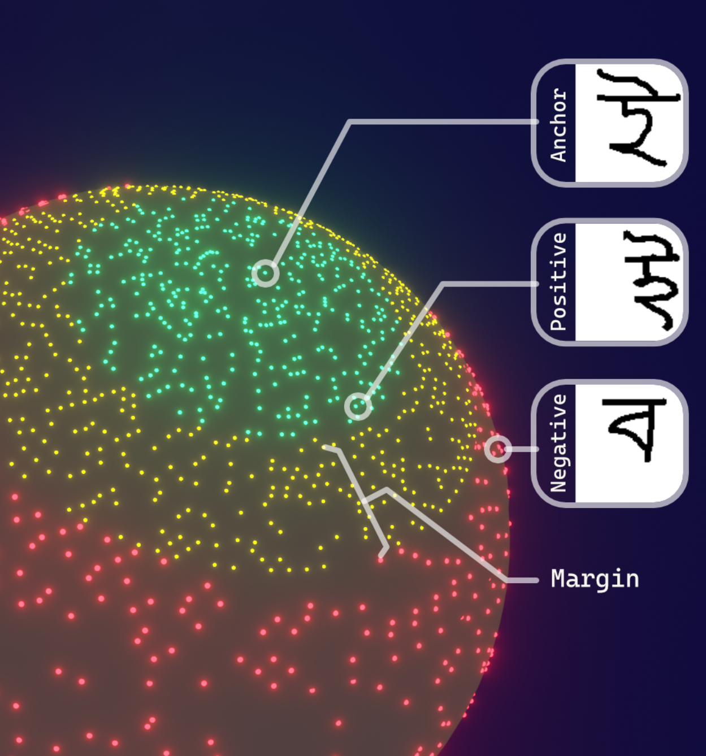
Embeddings on higher dimension – 3D sphere

Slide 16
Methodology
Dataset consists of 1173 patient records, out of which 77 (6.6%) had AKI and 1,096 (93.4%) who did not – fairly imbalanced dataset
Each record consists of patient’s data – 20 feature columns and one target column - Kidney Disease: Improving Global Outcomes (KDIGO)
APN pairs and Anchor embeddings are generated as discussed earlier to train the Triplet Network and Downstream classifier model.
ROC curve and per label F1 score are used performance evaluation metrics to compare base paper and the proposed system.

Slide 17
Methodology – Two Approaches
Approach 1 – Without Over-Sampling
The no. of train and test triplets generated were 7800 and 3450 respectively
Triplet Siamese Network (Upstream Model)
Alpha/Margin: 0.8
Embedding Dimension: 35
Optimizer: Custom Adam with lr = 0.0001, beta_1 = 0.9 and beta_2=0.999, epsilon= 1e-08
Total Trainable Parameters: 4,333,603
Fully connected Neural Network Classifier (Downstream Model Type 2)
Input shape: 35
Optimizer: Default Adam
Total Trainable Parameters: 12,994
CNN Classifier (Downstream Model Type 1)
Input shape: 1 x 35 x 1
Optimizer: Default Adam
Total Trainable Parameters: 6,073,090
Approach 2- With Over-Sampling
The no. of train and test triplets generated after oversampling were 56000 and 24000 respectively.
Triplet Siamese Network (Upstream Model)
Alpha/Margin: 0.8
Embedding Dimension: 128
Optimizer: Custom Adam with lr = 0.0001, beta_1 = 0.9 and beta_2=0.999
Total Trainable Parameters:
CNN Classifier (Downstream Model)
Input shape: 16 x 8 x 1
Optimizer: Default Adam
Total Trainable Parameters:

Slide 18
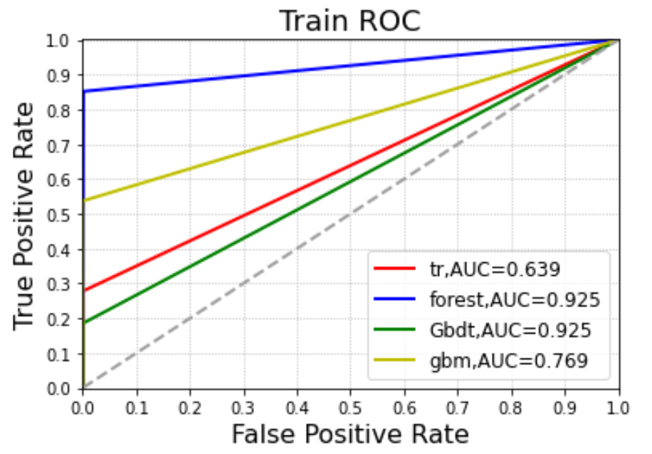
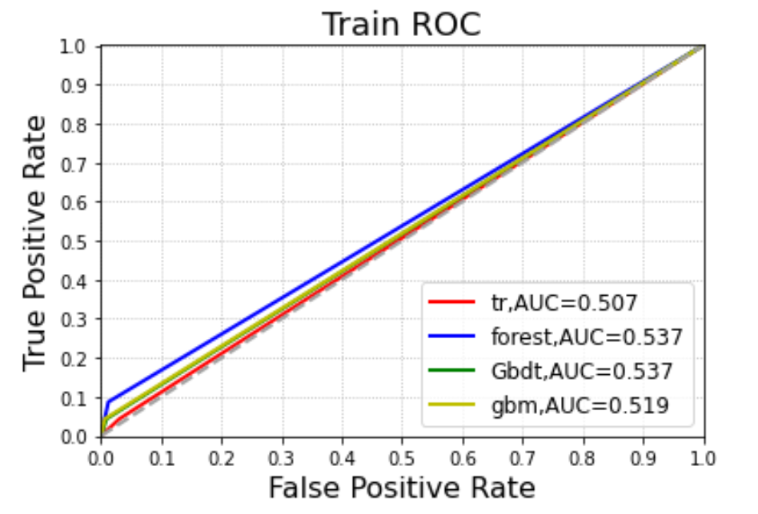
Base Paper Implementation – ML Model Results
ROC Curve for Train Data
ROC Curve for Test Data

Slide 19
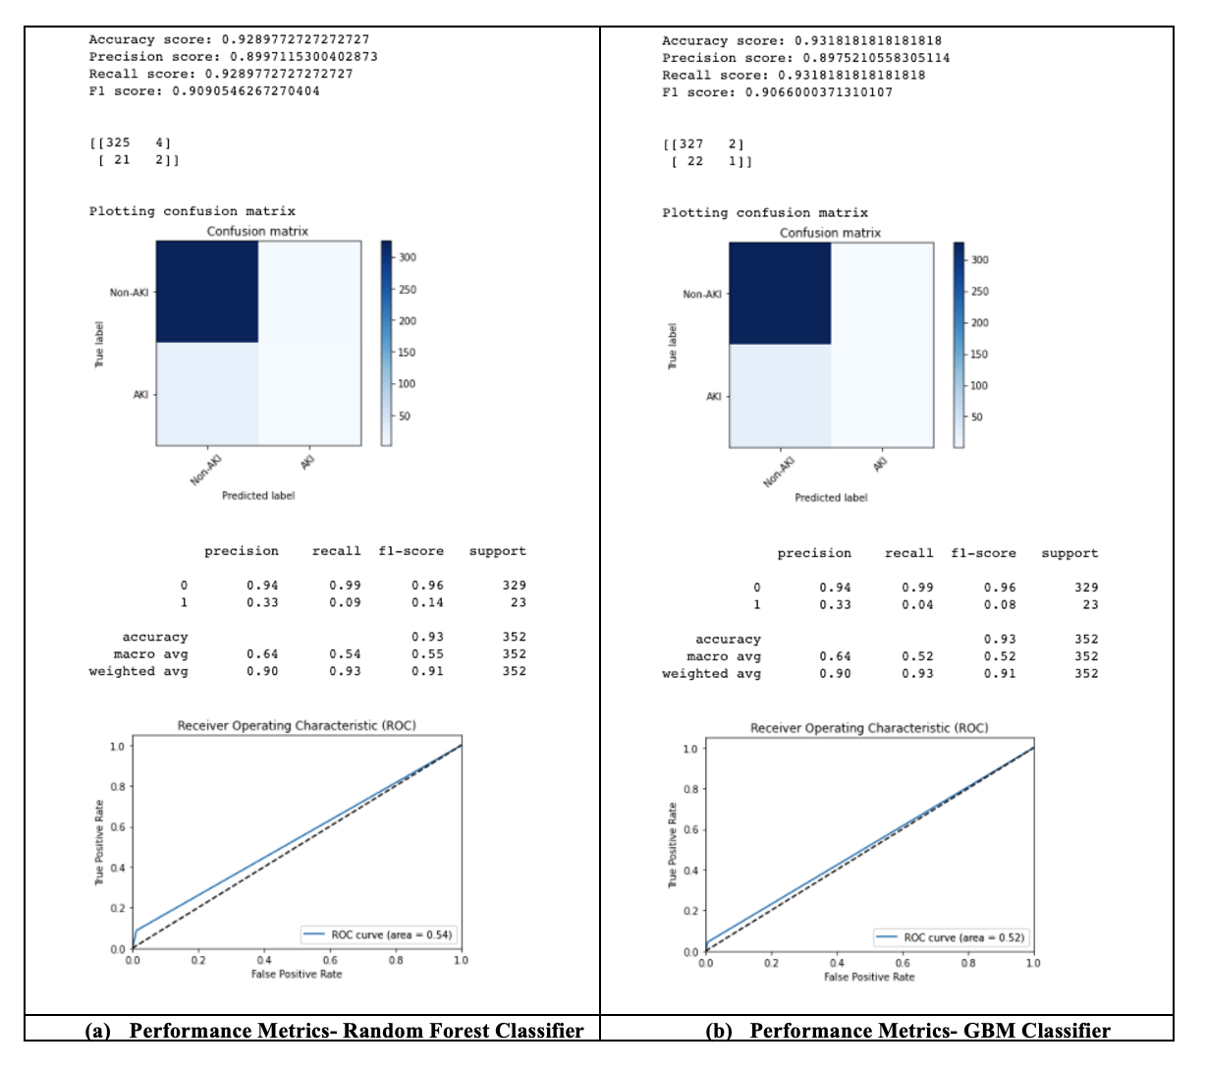

Slide 20
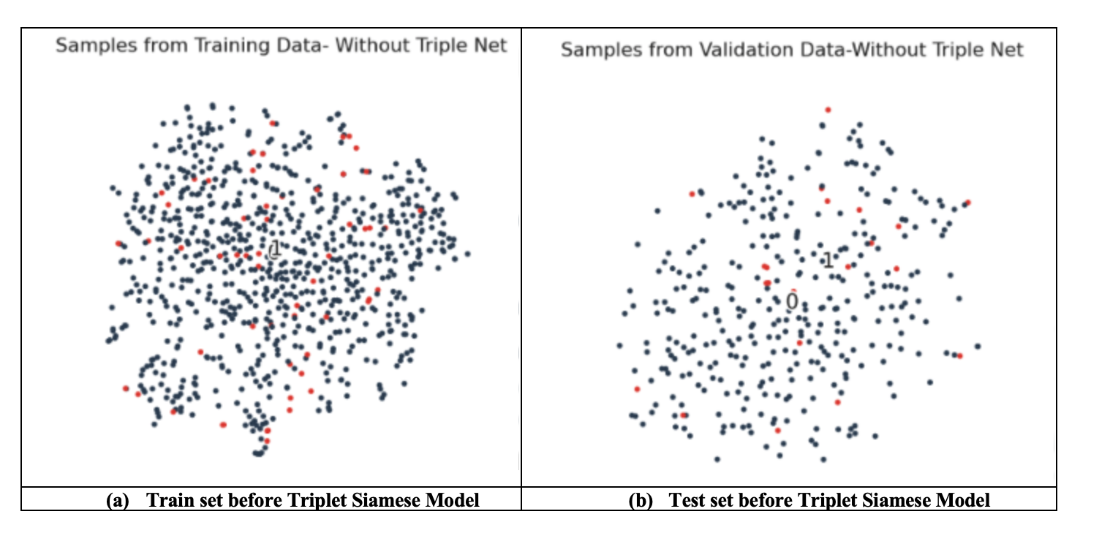
Proposed System – Approach 1 Results
Before Training through Triplet Siamese Network

Slide 21
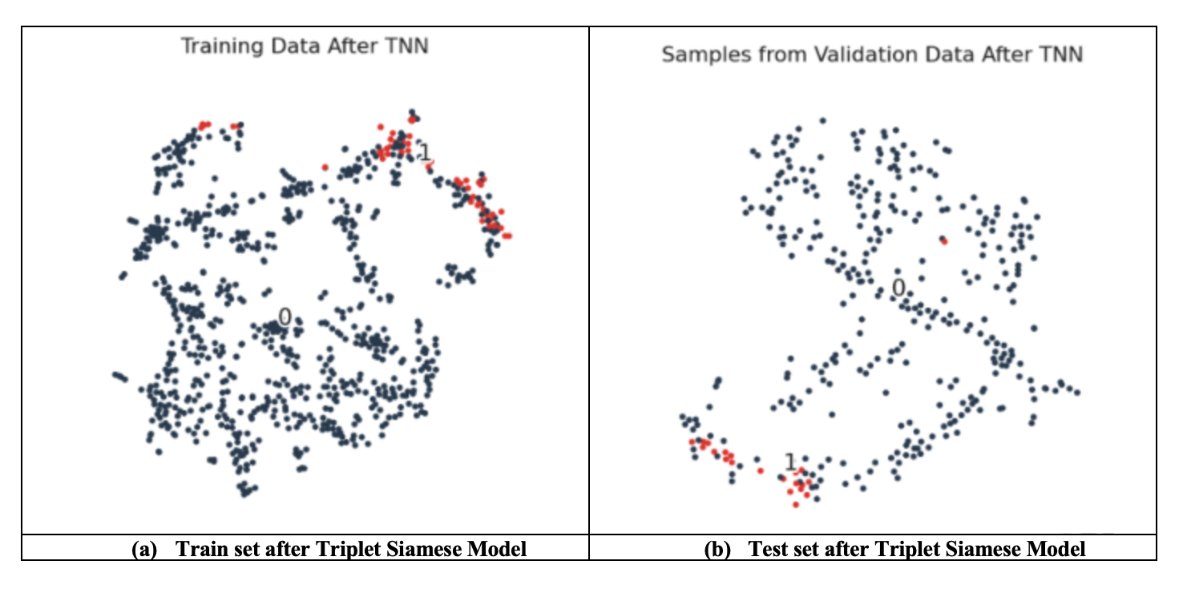
Proposed System – Approach 1 Results
After Training through Triplet Siamese Network

Slide 22
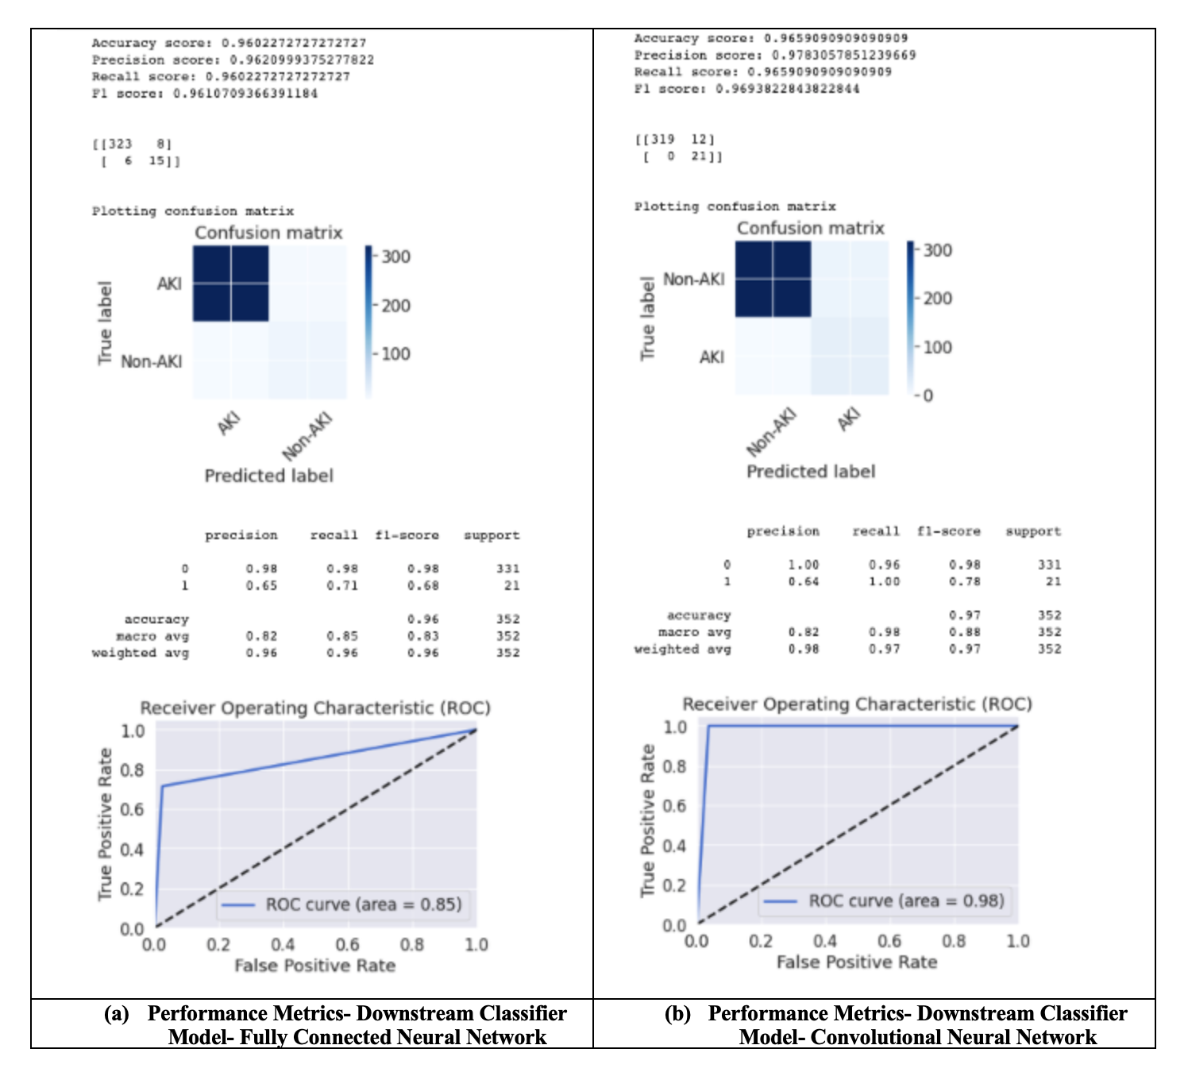
Proposed System – Approach 1 ROC curve and Confusion matrix

Slide 23
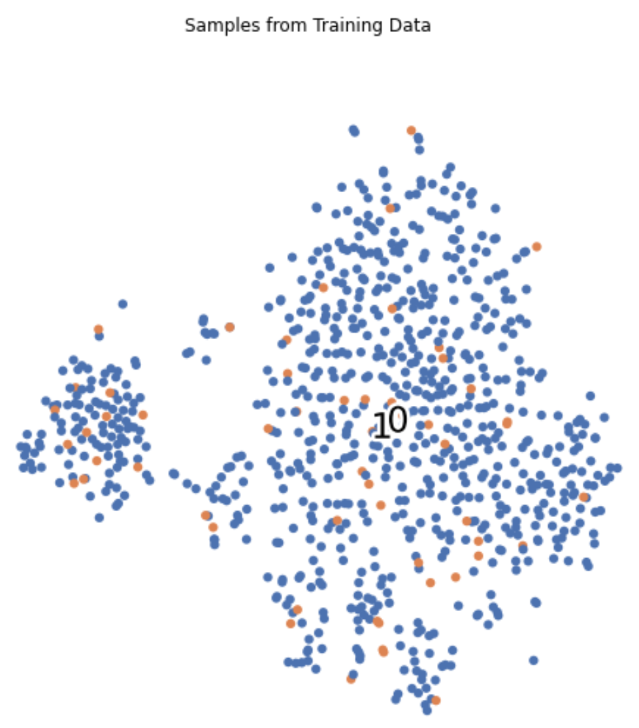
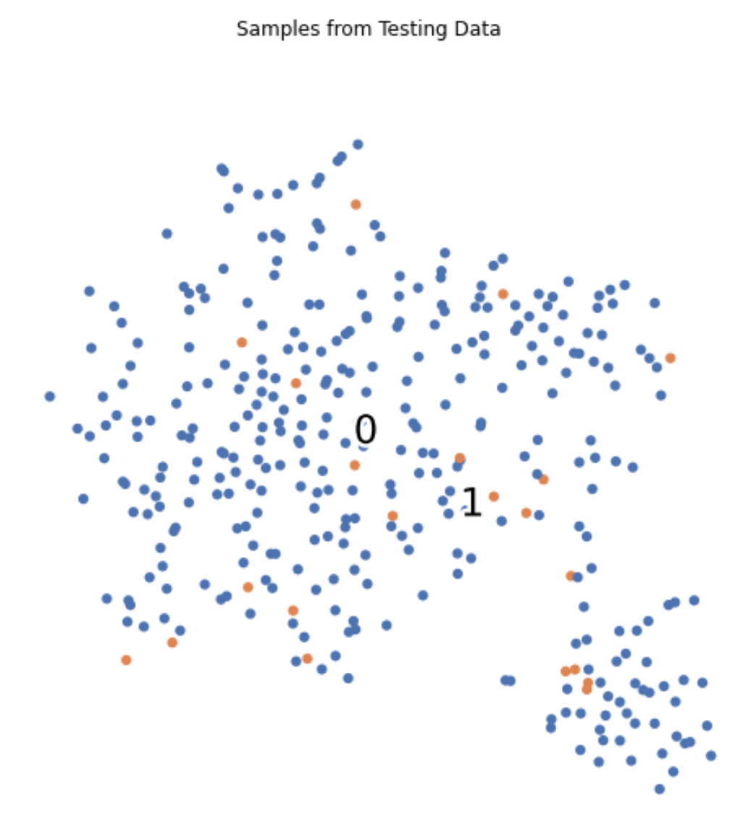
Proposed System – Approach 2 Results
Before Training through Triplet Siamese Network

Slide 24
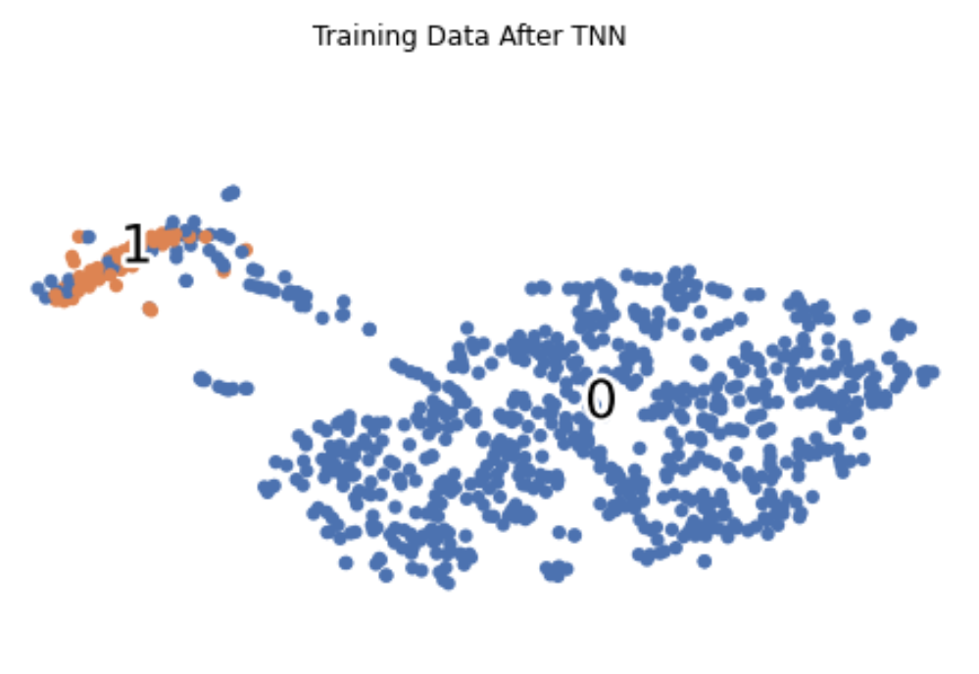
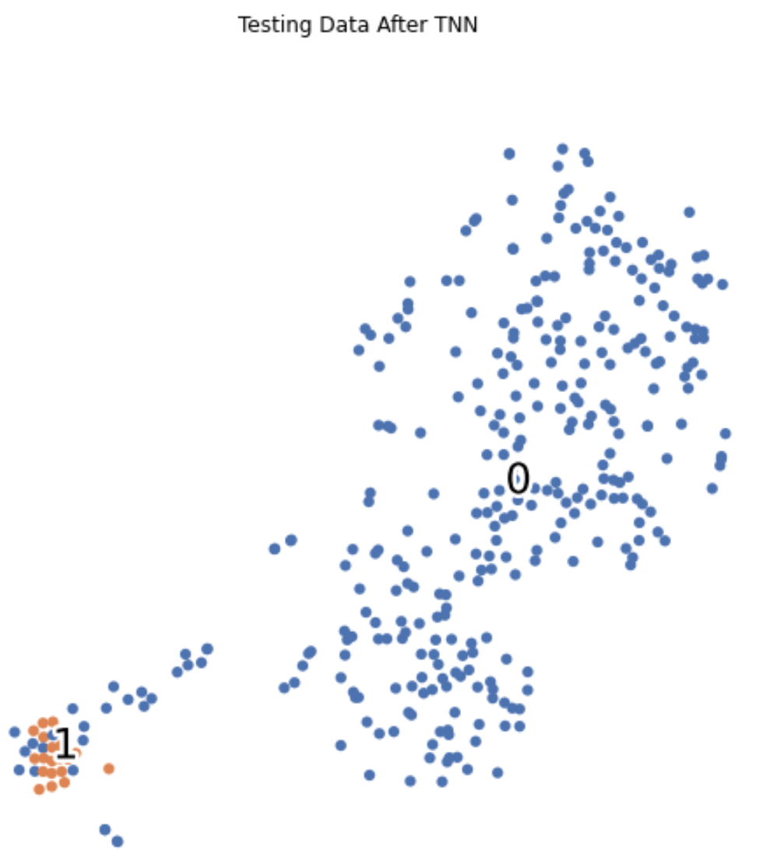
Proposed System – Approach 2 Results
After Training through Triplet Siamese Network

Slide 25
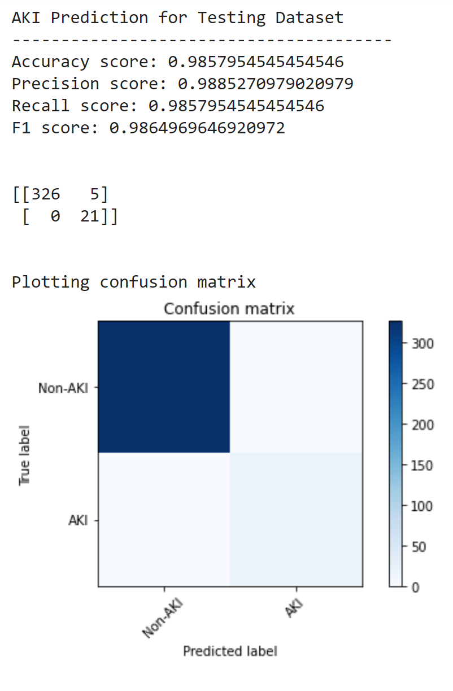
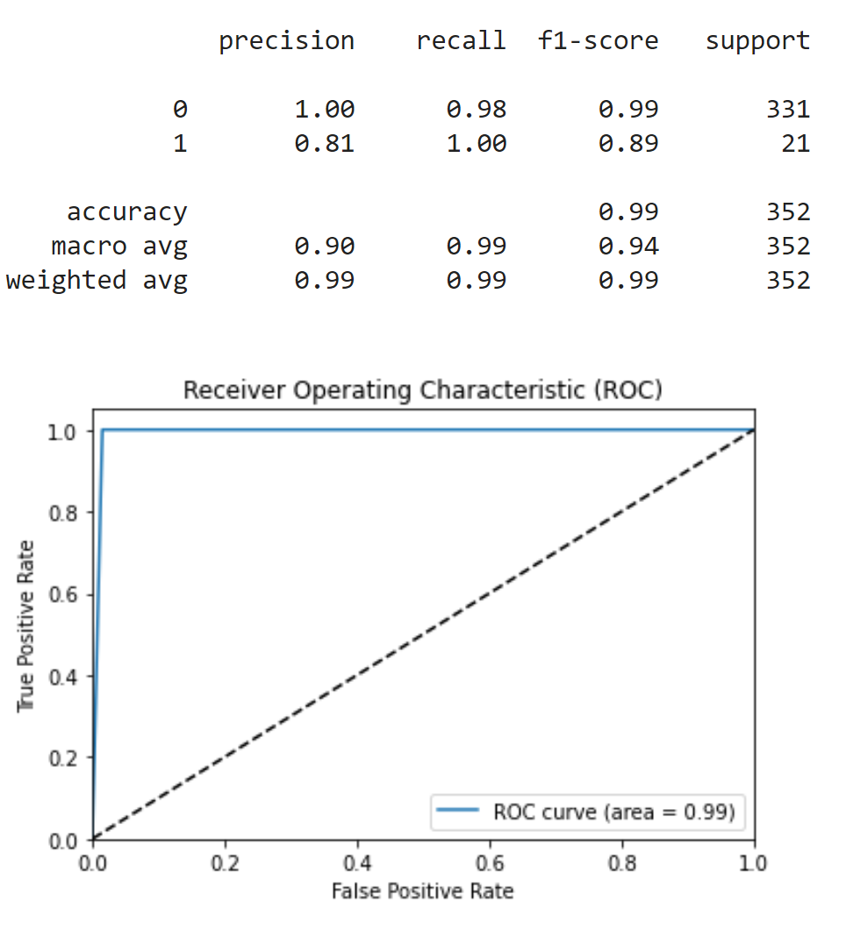
Proposed System – Approach 2 ROC curve and Confusion matrix

Slide 26
Comparison of ML models vs Proposed AI ensemble
Based on per label F1 scores
Model | Non-AKI (Class 0) | AKI (Class 1)
Machine Learning Model Performance
Decision Tree | 0.95 | 0.06
Random Forest | 0.96 | 0.14
GBM | 0.96 | 0.08
Gbdt | 0.96 | 0.07
Triplet Siamese Model + Deep Learning Classifier System Performance
Approach 1 - FCNN | 0.98 | 0.68
Approach 1 - CNN | 0.98 | 0.78
Approach 2 - CNN | 0.99 | 0.89

Slide 27
Challenges and Takeaways
Steep learning curve since it was a new concept – One Shot Learning
Challenging since this approach is usually applied on images and we had to implement it to numerical dataset
Understanding the working of different components of Triplet Network – Triplet generation, triplet loss function and embedding model
We faced dimensionality issues during - APN creation, while sending it to embedding and downstream model
Understanding medical data and terminologies

Slide 28
Task Division
Team Member
Harshitha | Research & Analysis, Base Paper Performance Metrics, Approach 2- Data preprocessing, Triplet generation, Triple Loss function, Triple Siamese Model implementation, Triplet embedding visualization, downstream CNN Model, Performance Metrics, Documentation
Gargi | Research & Analysis, Base Paper re-implementation, Approach 1- Data preprocessing, Triplet generation, Triple Loss function, Triple Siamese Model implementation, Triplet embedding visualization, downstream FCNN, CNN Model, Performance Metrics, Documentation

Slide 29
References
https://heartbeat.fritz.ai/one-shot-learning-part-1-2-definitions-and-fundamental-techniques-1df944e5836a
https://www.kidneyfund.org/kidney-disease/kidney-problems/acute-kidney-injury.html

Slide 30
THANK YOU

